Slide 1
Create a communications site for your campaign
Get your campaign on the same page with a SharePoint communications site. Share the strategy, events, and media assets your team needs all on one page. Learn how to build it with modern SharePoint web parts.

Slide 2
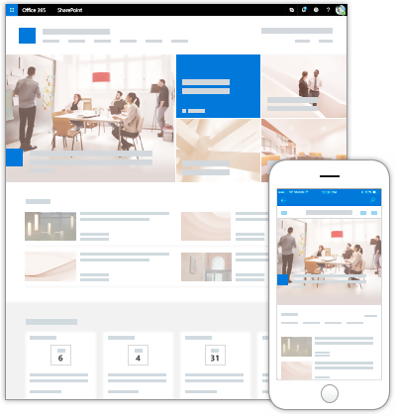
Create the site
SharePoint
1
In SharePoint, choose + Create site and select the Communication site option.
2
Choose the Topic design and type a site name and description.
6
4
31

Slide 3


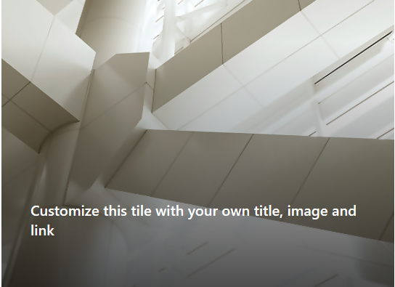
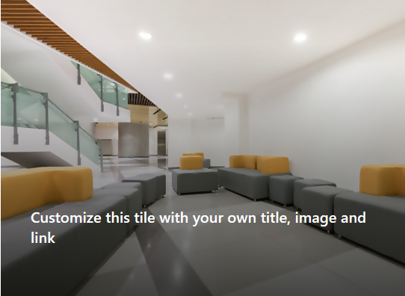
Add a theme and logo
Add your campaign logo and customize the theme to fit your campaign.
Choose and customize a theme
1
On your site, click Settings and then click Change the look > Theme.
Red
Abc
Customize
2
Select a theme, and then choose Customize to change the accent color.
Add a logo
1
On your site, click Settings and then click Change the look > Header.
Our Campaign
2
Under Site logo, choose Change.
3
Select your logo and choose Open.
4
Choose Save.
Learn more:
aka.ms/ChangeLook

Slide 4
Add your key information and candidate statement
Update the top Hero web part to point to key information for your campaign, such as:
Add a candidate statement
Share a recent message from your candidate. Use the Text web part to format the text and make this front and center, just under the hero information.
Strategy information
Key messaging
Important documents to share
Directory
This is text in a pull quote.
FAQ
Learn more:
aka.ms/HeroWebPart
Learn more:
aka.ms/TextWebPart

Slide 5
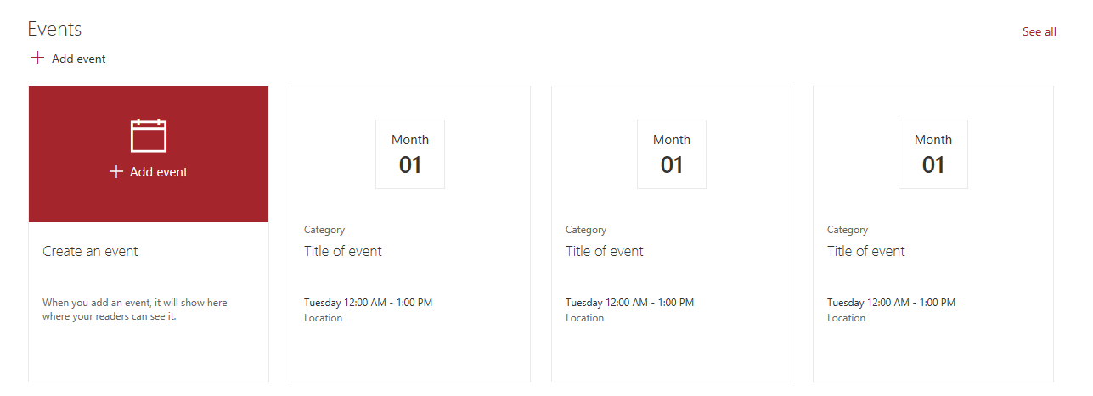





Add events and images
Add events
Events
See all
Use the Events web part to share information about upcoming events.
Add event
Month
Add event
01
Learn more:
aka.ms/EventsWebPart
Add photos and images
Make sure your campaign staff is using approved photos and images – share them to your Communications site using the Image Gallery web part so that staff can quickly browse and find the image they need.
Learn more:
aka.ms/ImageGalleryWebPart
For more information, visit: aka.ms/M365CampaignsComms

